Slide 1




ChatGPT and GitHub Copilot in Four Hours
Tim Warner
Technical Trainer and Author
TechTrainerTim.com

Slide 2

Tim Warner
Based in Nashville, TN, US
28-year Microsoft Certified Trainer (MCT)
7-year Microsoft MVP in Cloud / Datacenter Mgmt
Contact: TechTrainerTim.com

Slide 3
Class Schedule (Central Time)
09:00 am - Segment 1 [ChatGPT Basics]
10:00 am - 10-min break - Segment 2 [ChatGPT Advanced]
11:00 am - 10-min break - Segment 3 [GitHub Copilot Basics]
12:00 pm - 10-min break - Segment [GitHub Copilot Advanced]
01:00 pm - Finish

Slide 4




Learning Objectives
Differentiate major LLMs, including ChatGPT and GitHub Copilot
Gain hands-on experience with prompt crafting and AI output analysis
Apply AI-driven insights in both professional and personal contexts

Slide 5
Session Materials
timw.info/chatgptclass
github.com/timothywarner/chatgptclass

Slide 6
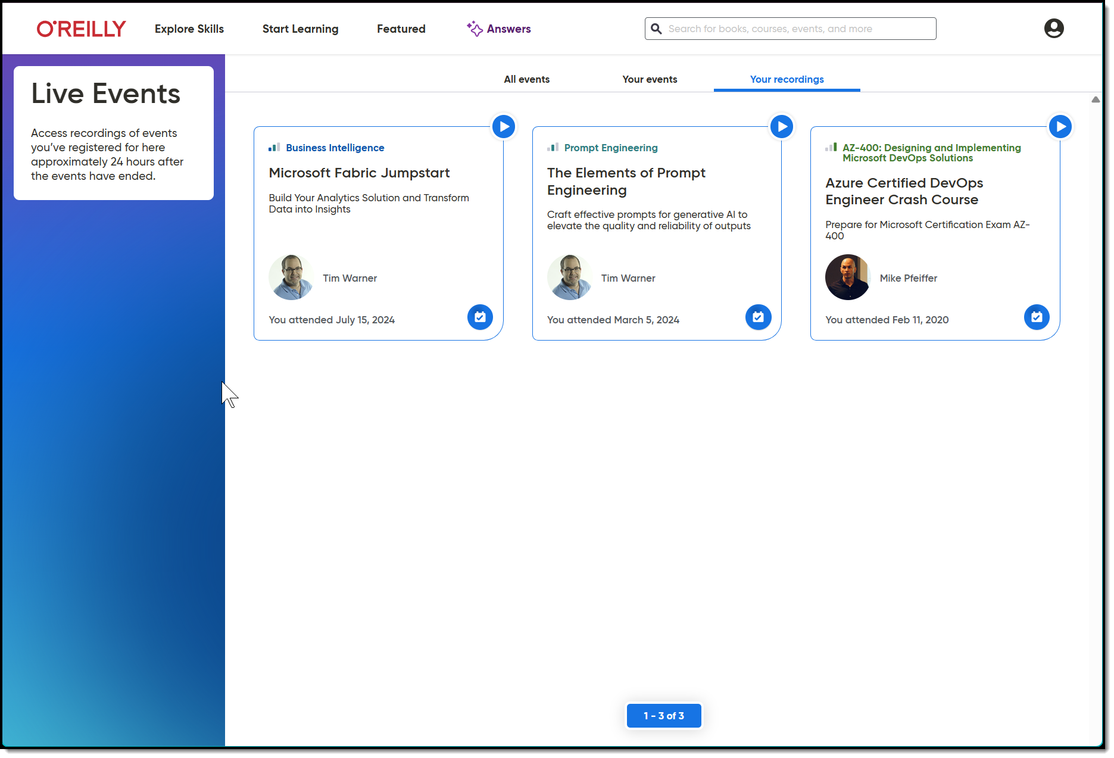
Session Recording + Badge

Slide 7
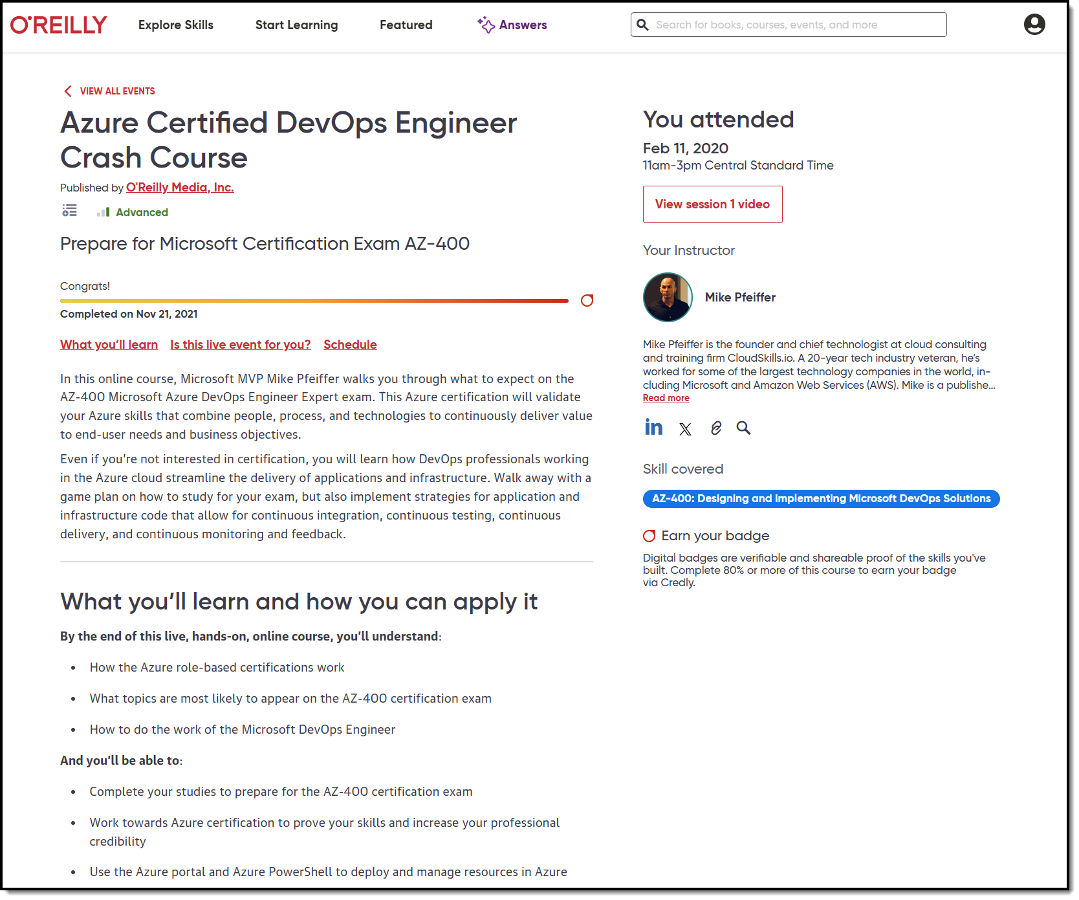
Session Recording + Badge

Slide 8
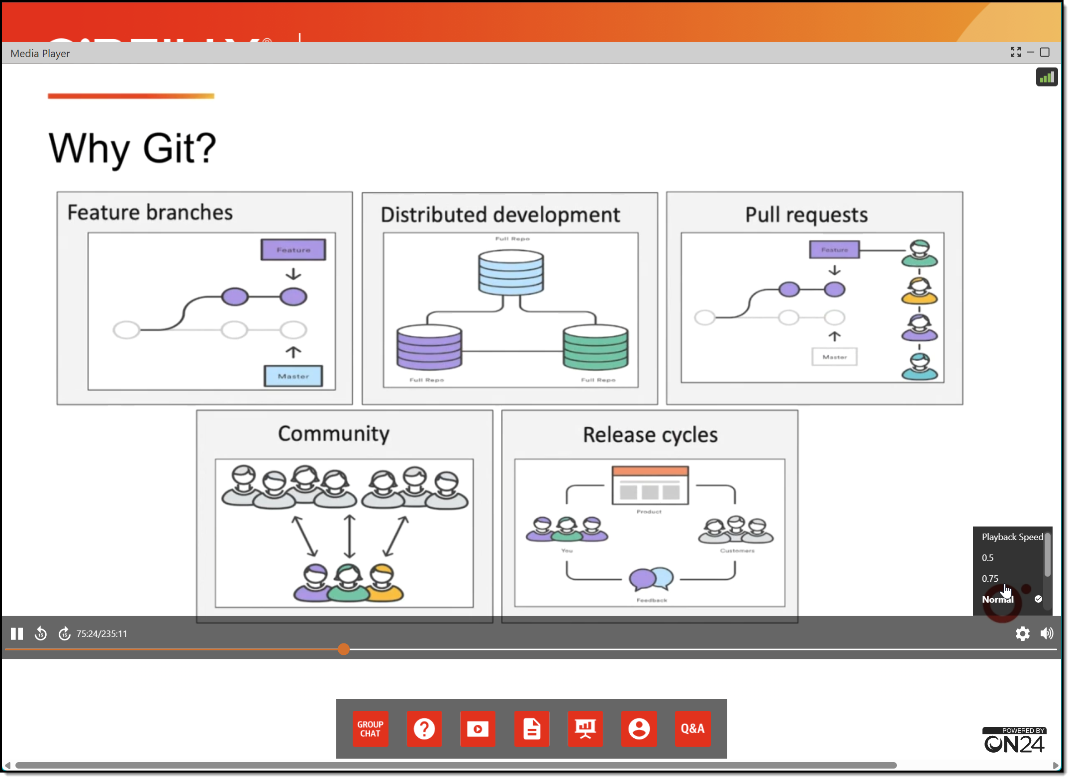
Session Recording + Badge

Slide 9
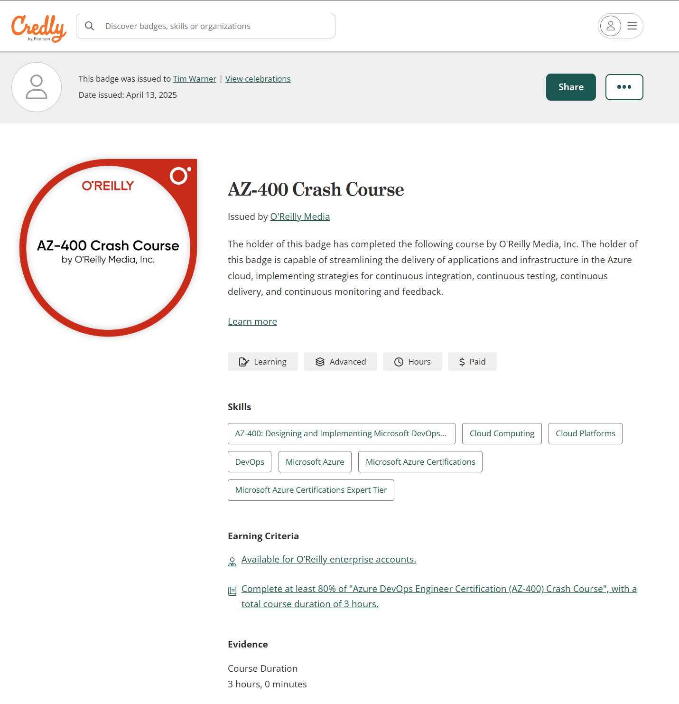
Session Recording + Badge

Slide 10



Keeping an LLM on task be like…

Slide 11
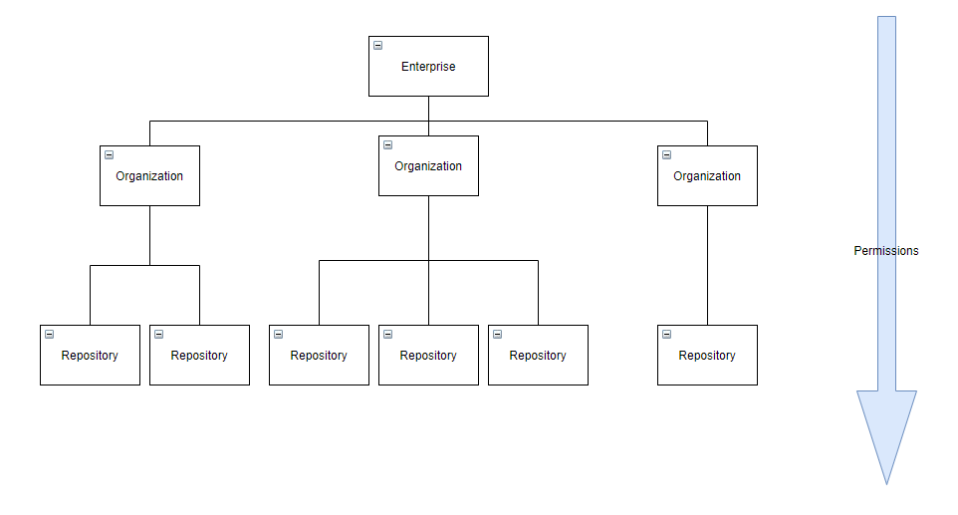
GitHub Enterprise Cloud (GHEC)
Reference: https://github.com/dduzgun-security/github-enterprise-cloud-configuration

Slide 12
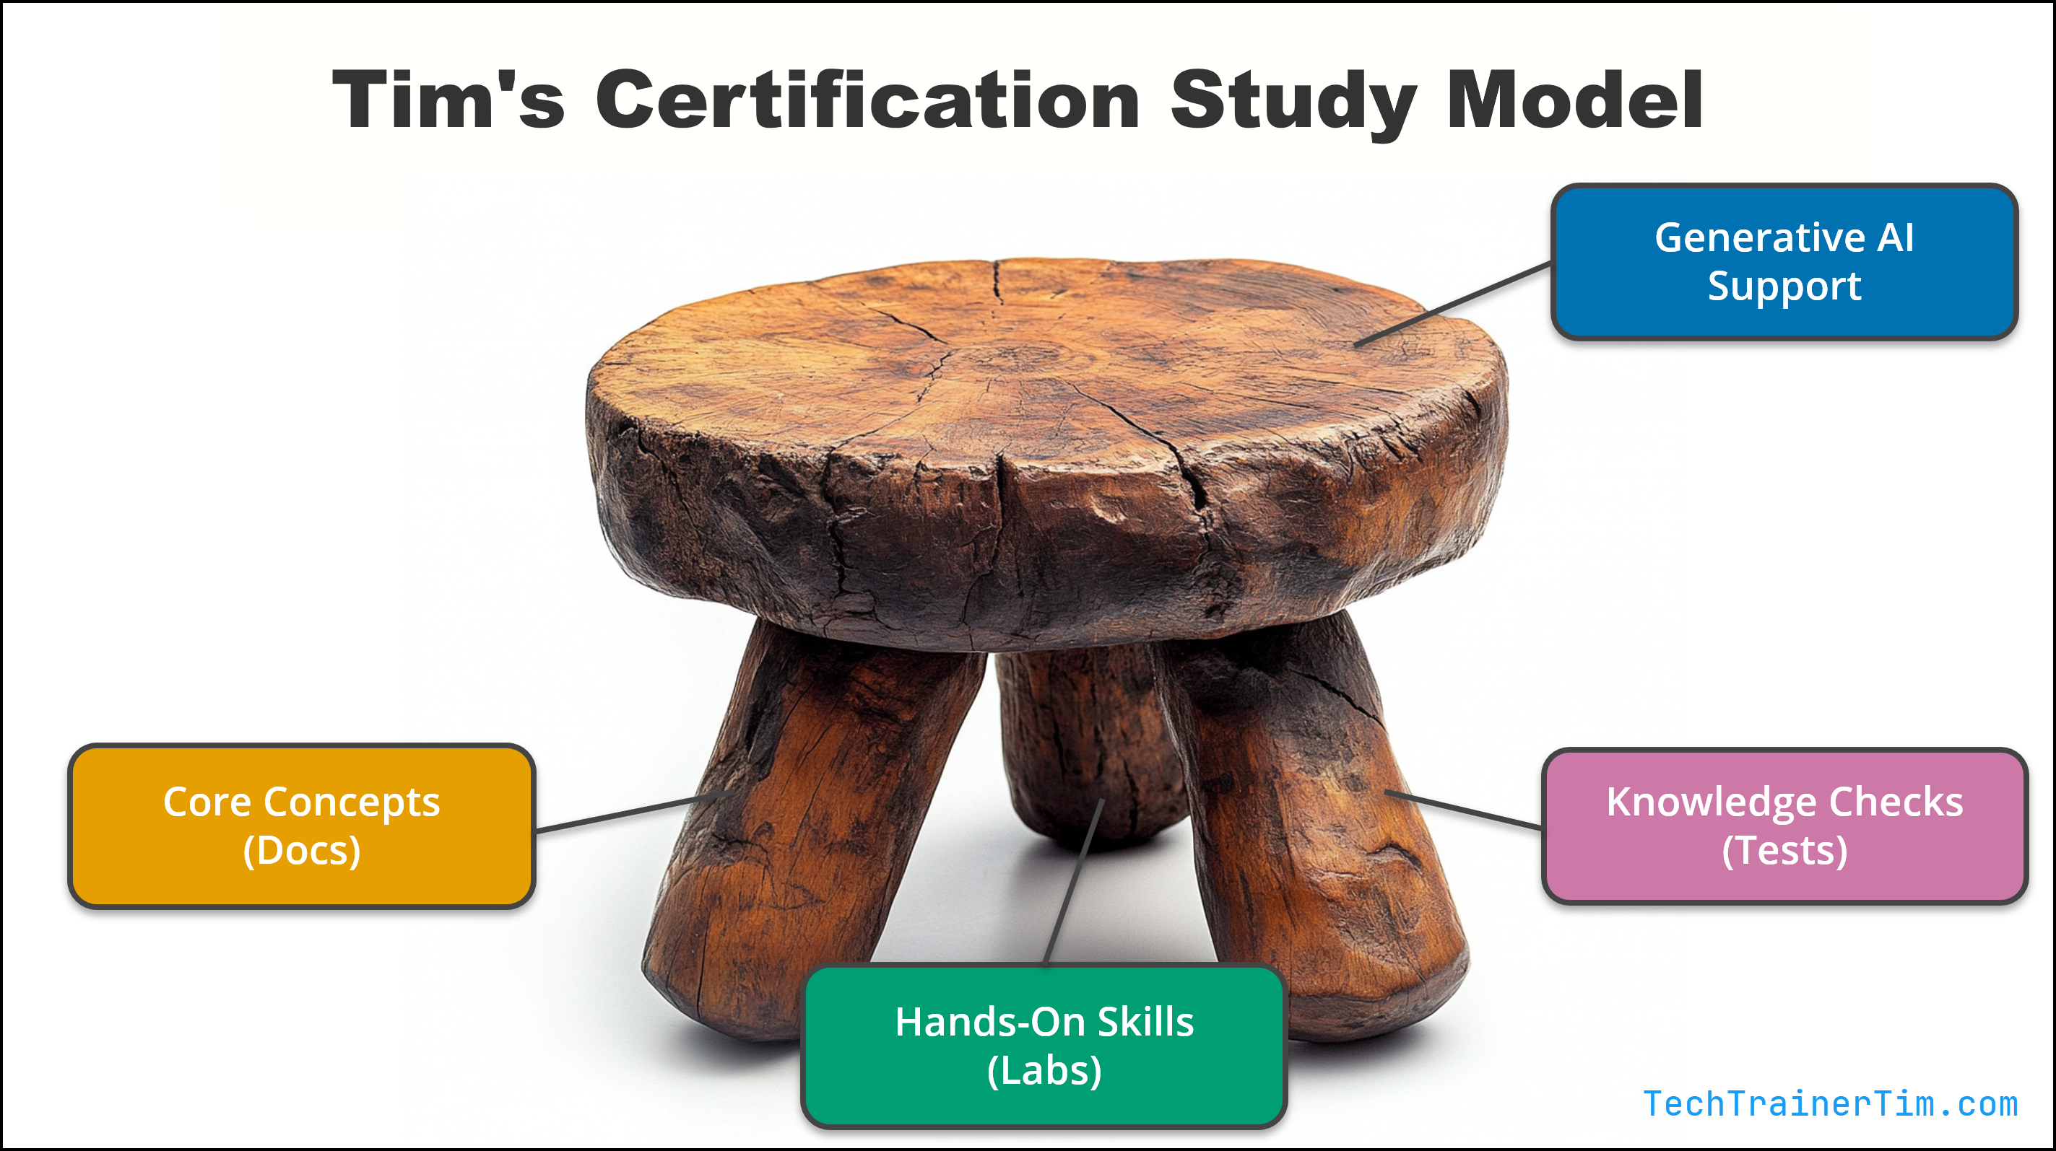

Tim's IT Certification Study Model

Slide 13
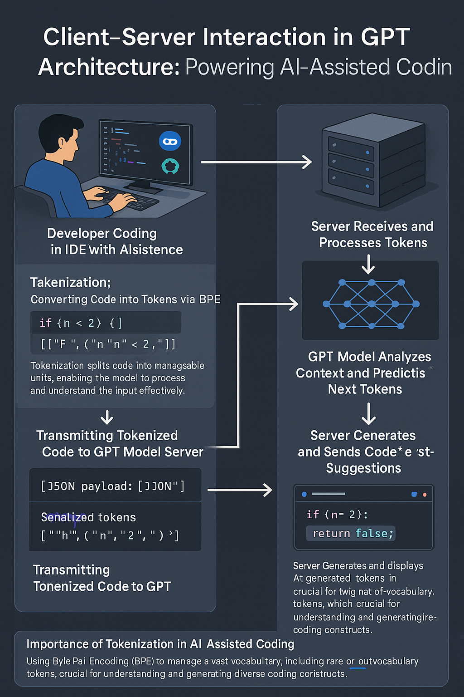
GPT Basic Architecture
OpenAI GPT 4o Image Generation
Multimodal generative AI
Two ways to improve model:
Fine tuning
Retrieval Augmented Generation (RAG)

Slide 14

Neural Network
go.techtrainertim.com/cloud

Slide 15
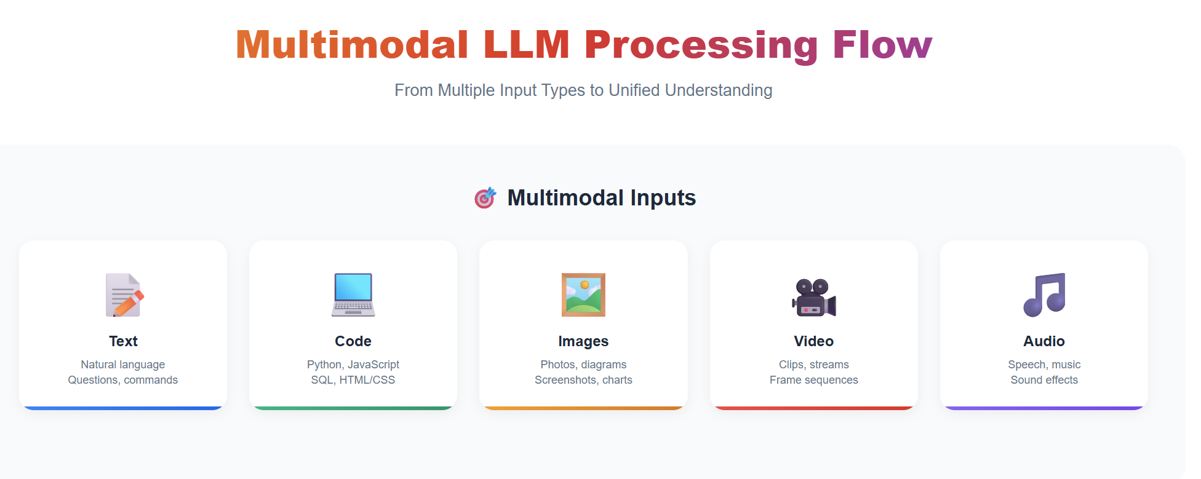
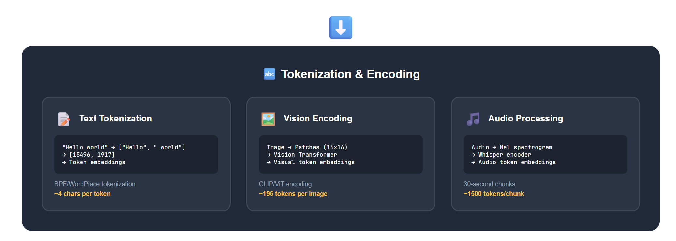
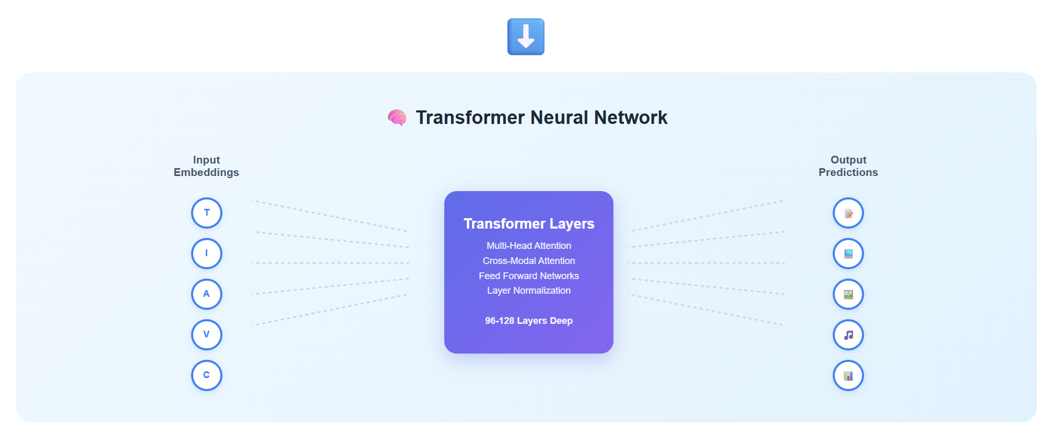
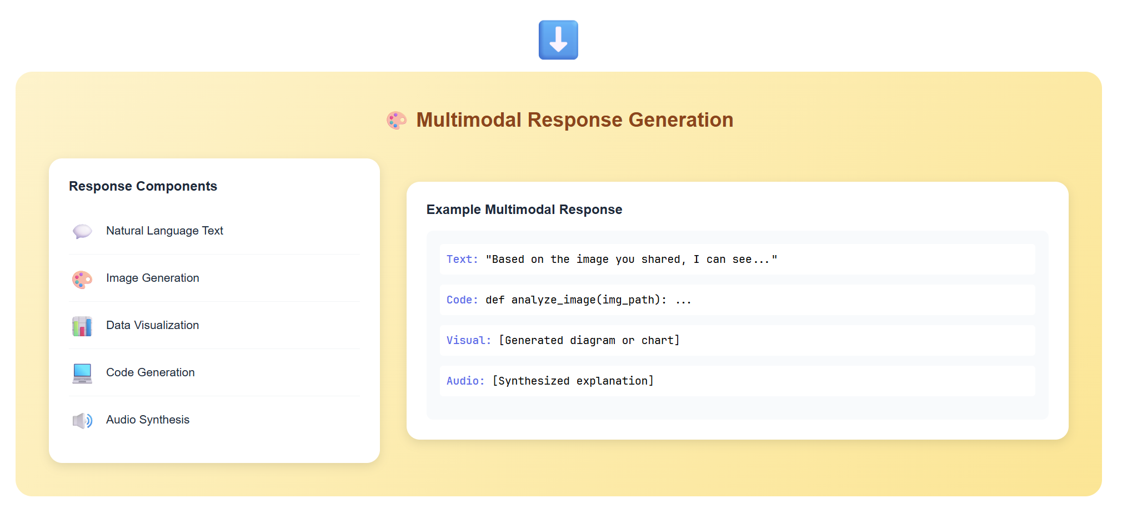

Slide 16

Context Length

Slide 17
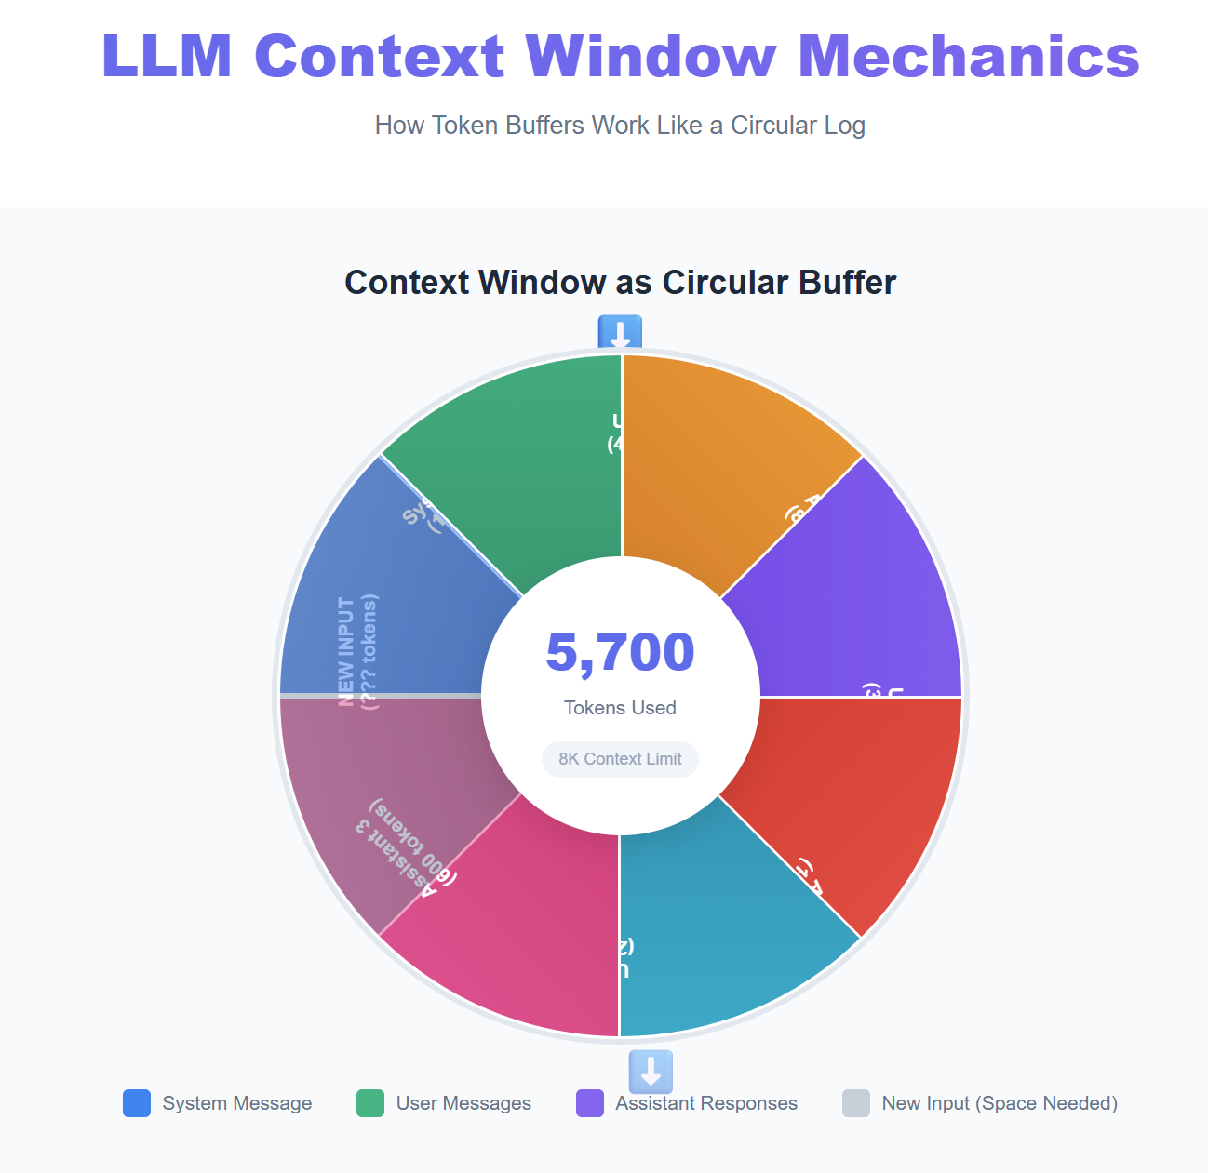
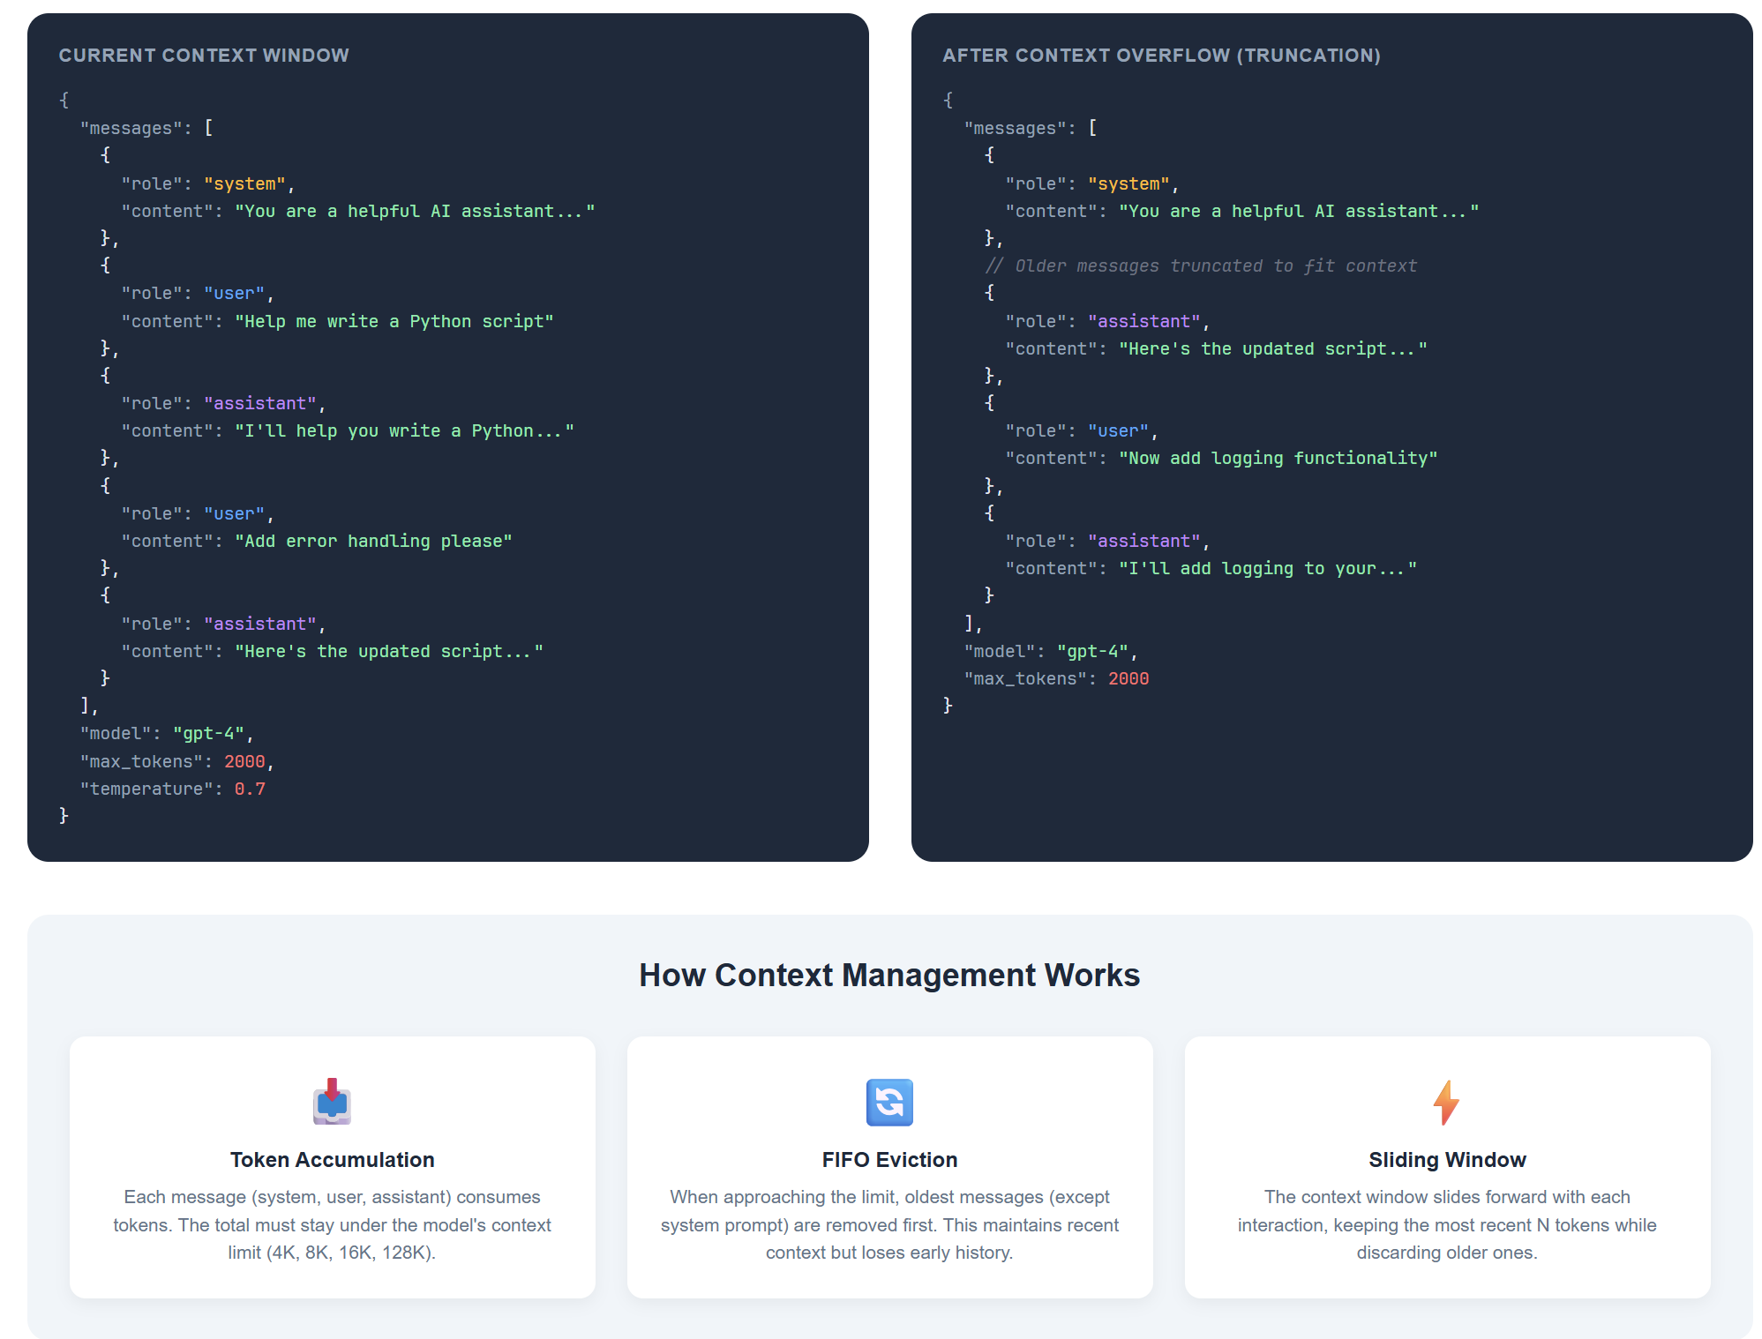

Slide 18
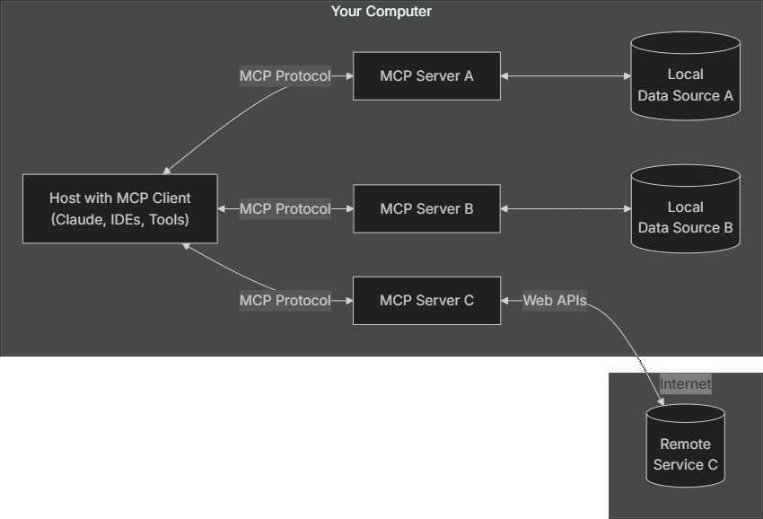
Anthropic Model Context Protocol (MCP)
modelcontextprotocol.io

Slide 19
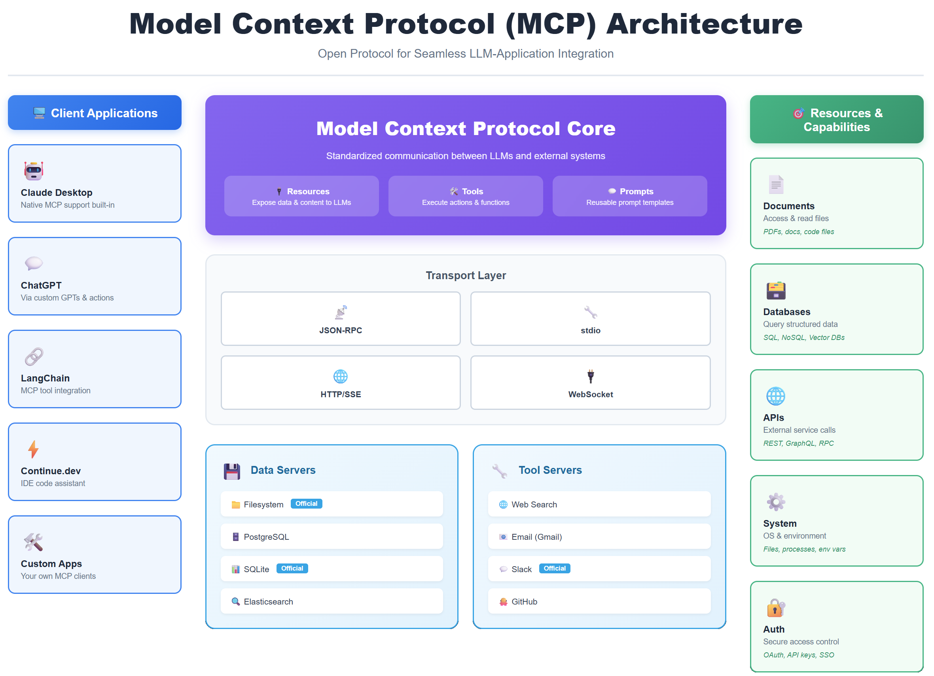

Slide 20
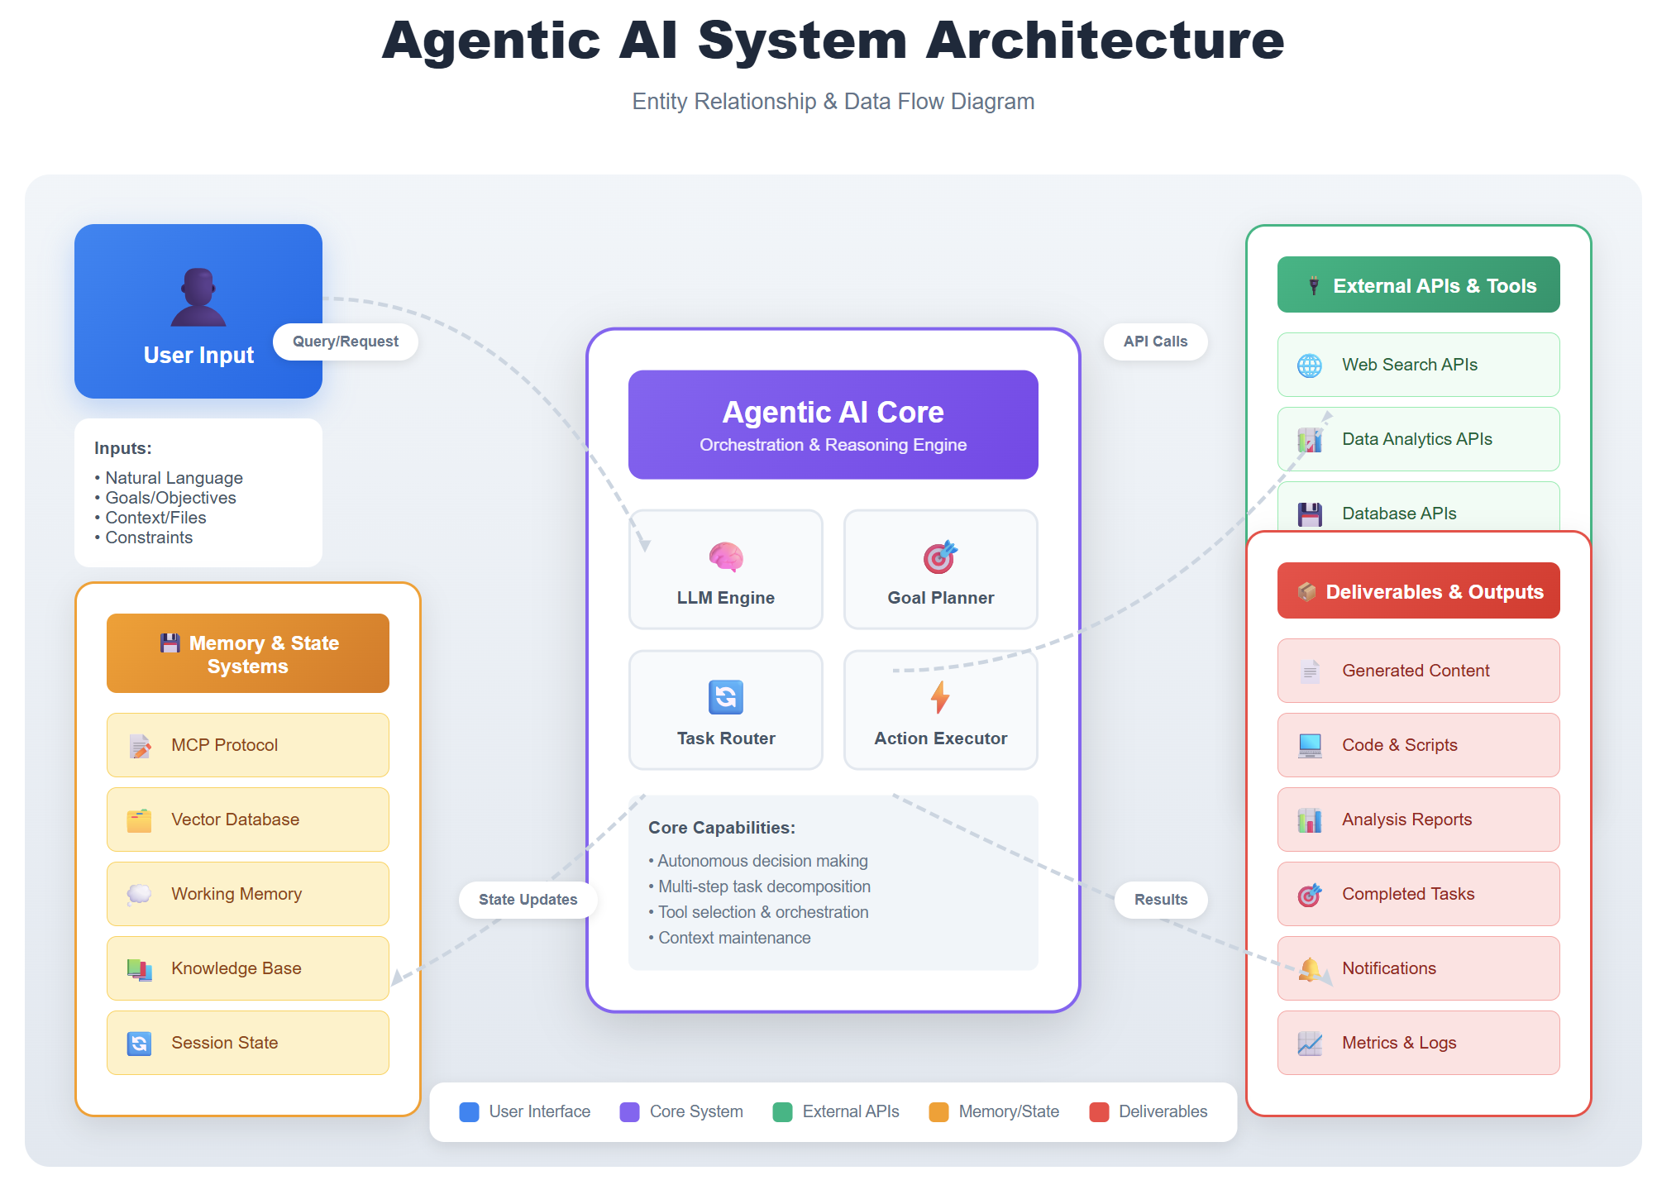

Slide 21
Ready?

Slide 22
Foundational Terminology

Slide 23
Artificial Intelligence (AI)
The field of computer science dedicated to creating machines that can perform tasks requiring human-like intelligence, such as problem-solving, learning, and understanding natural language.

Slide 24
But wait...What if we used...

Slide 25
A Truly Real-World Live Classroom Example
Situation: Tech moves so quickly but I need to deliver evergreen learning content to my students
Task: Embrace generative AI
Action: Use ChatGPT for the pedagogy and architecture; then GitHub Copilot to implement Actions automation
Result: A truly real-world case study and example for everyone's benefit

Slide 26
Let's switch into demo mode!
Like, right now.

Slide 27
Machine Learning (ML)
A subset of Artificial Intelligence that focuses on developing algorithms and statistical models to enable computers to learn from and make predictions or decisions based on data without explicit programming.

Slide 28
Neural Networks
Computational models inspired by the human brain, consisting of interconnected nodes or neurons, which are organized in layers and designed to recognize patterns and process complex data by adjusting the connections between nodes through a learning process.

Slide 29




New Paradigms...and Fear
1970s
Calculators
1980s
Robotics
1990s
WWW
2010s
AI

Slide 30
Preliminary Terminology
OpenAI is a research organization that aims to create safe and beneficial AI for humanity
ChatGPT is a large language model (LLM) that understands and generates natural language text

Slide 31
Preliminary Terminology
GitHub Copilot is an AI-powered pair programmer that suggests code snippets based on the context of your code
Azure OpenAI is a cloud-based platform that offers access to OpenAI's cutting-edge language models and AI capabilities

Slide 32

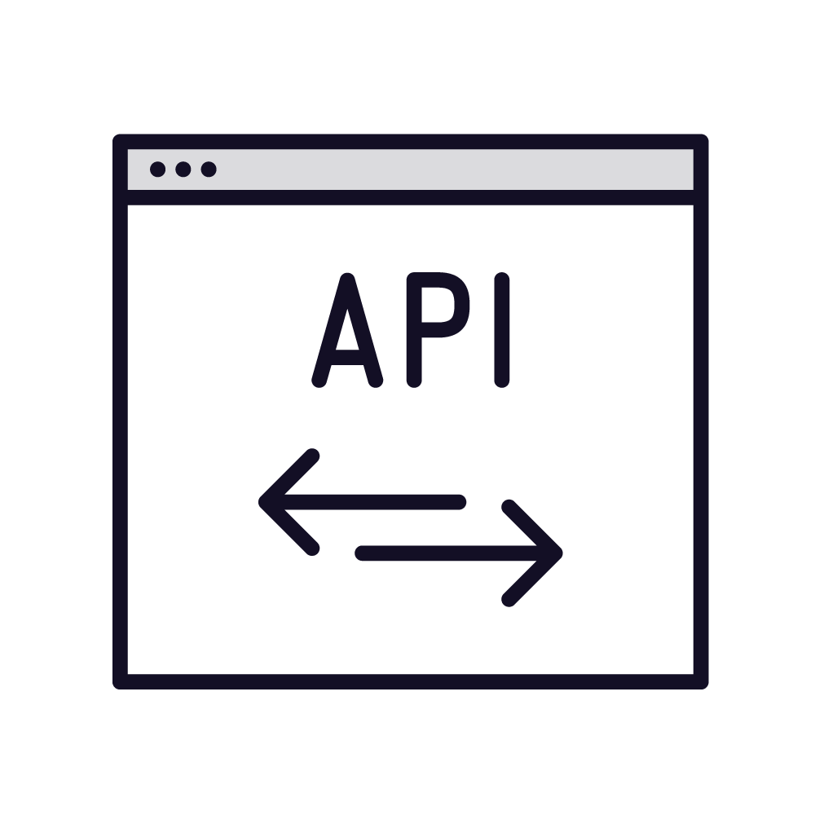


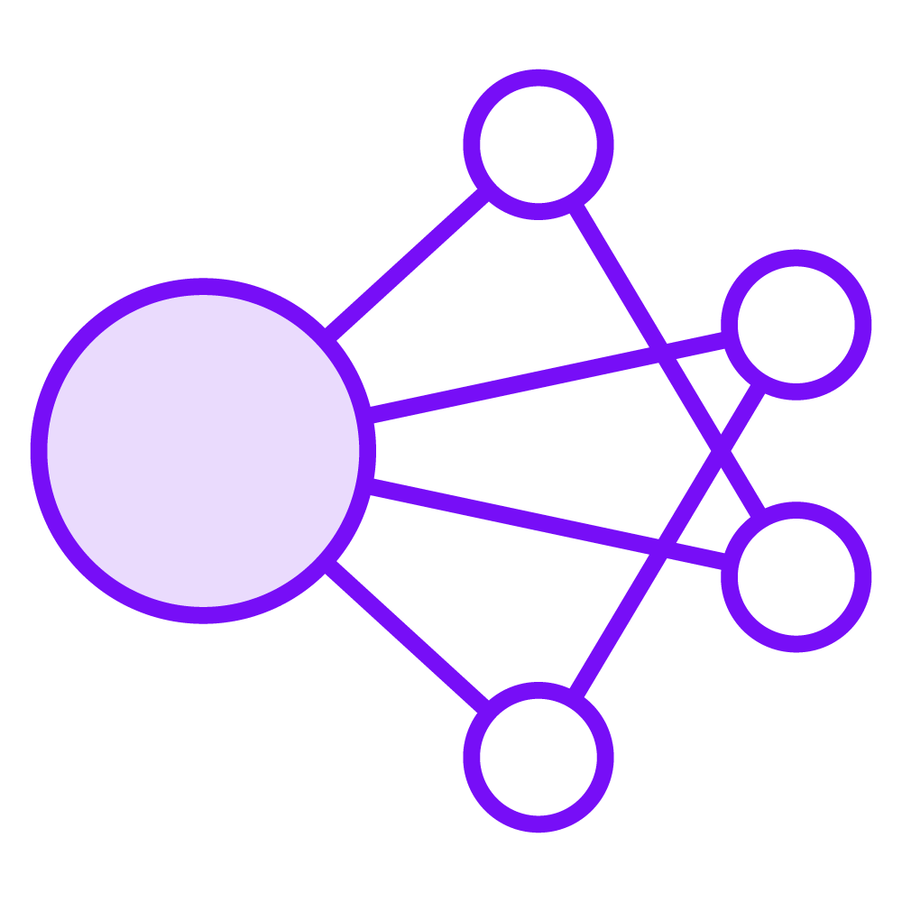



Machine Learning Model Training
New data
REST API
Prediction
Pattern identification
Algorithm
Training data
Test data
Big compute
Algorithm

Slide 33





REST APIs
POST https://api-server/api/operation?my=params
Client
Server
API key
Payload
Rate
limiting
HTTP 200 (OK)
Client
Server
Payload

Slide 34
The OpenAI Model Family

Slide 35
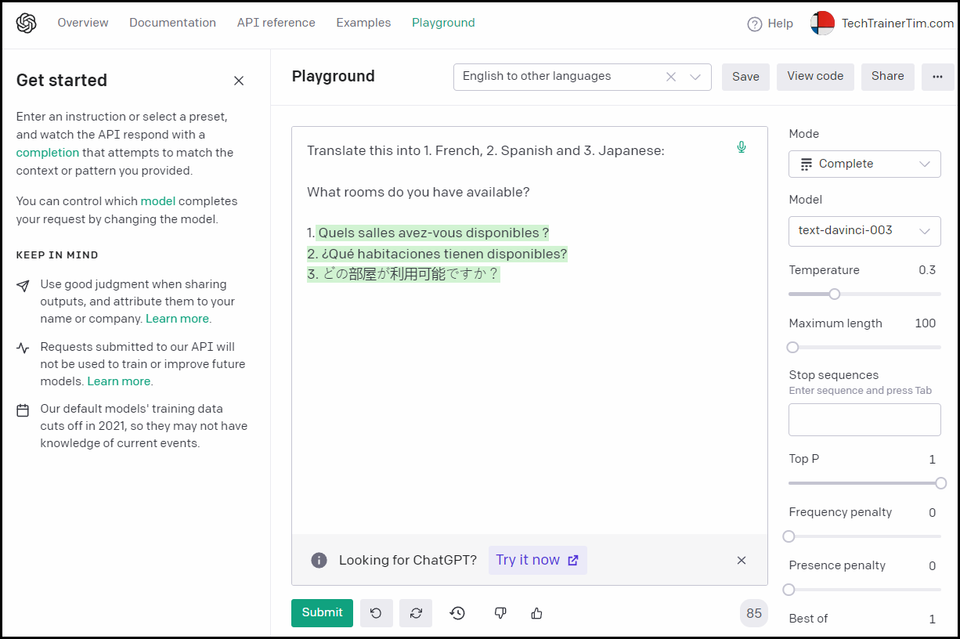
GPT
Generative Pre-Trained Transformer
Large Language Model (LLM)
Generate human-like text based on text prompts
GPT was originally released in 2018
Translation, summarization, question-answering, code generation

Slide 36
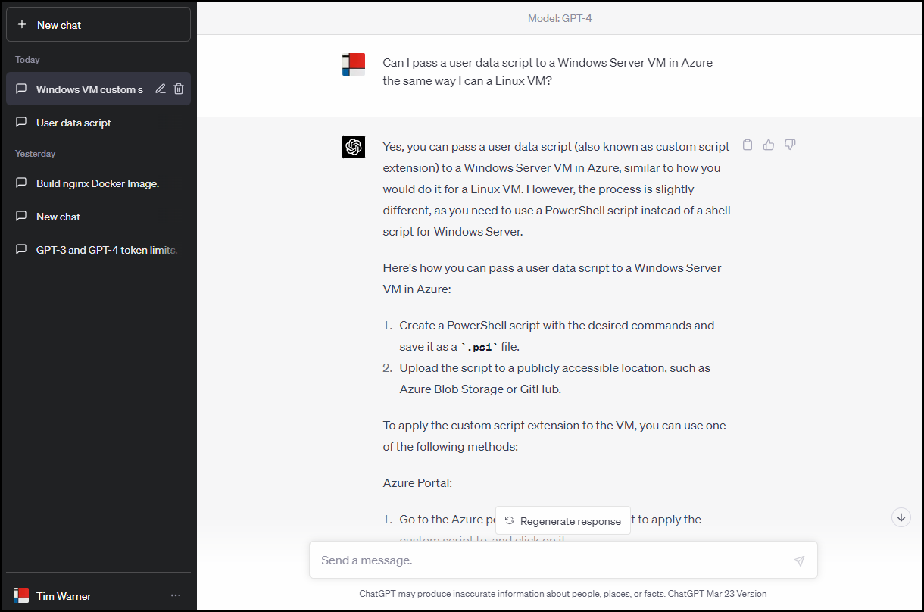
ChatGPT
Specialized version of GPT
Fine-tuned for human-like conversations
Context awareness
Engaging and interactive responses

Slide 37
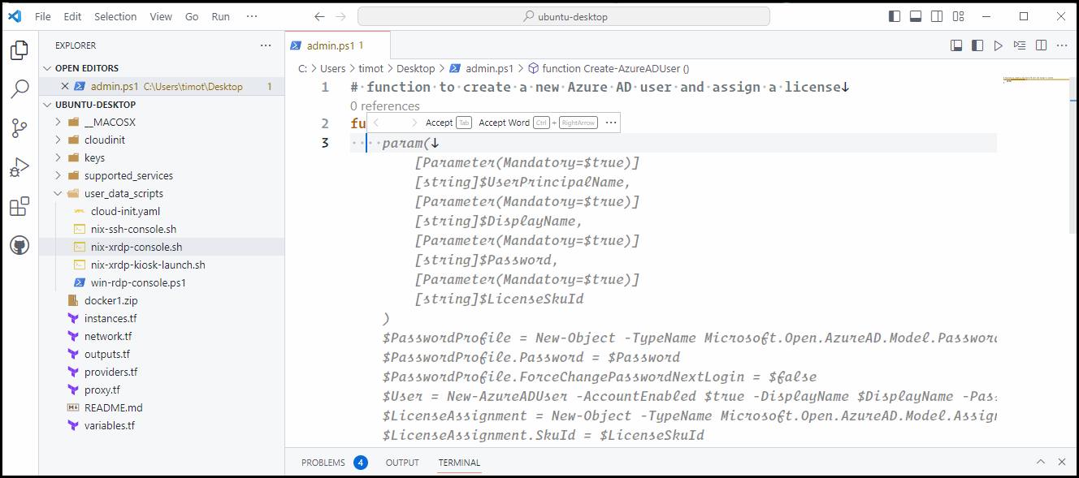
Codex
GPT-based model specializing on source code generation
Trained in part with GitHub open-source repos
Python is strongest (but not only) language
Code debugging/refactoring
Unit testing

Slide 38
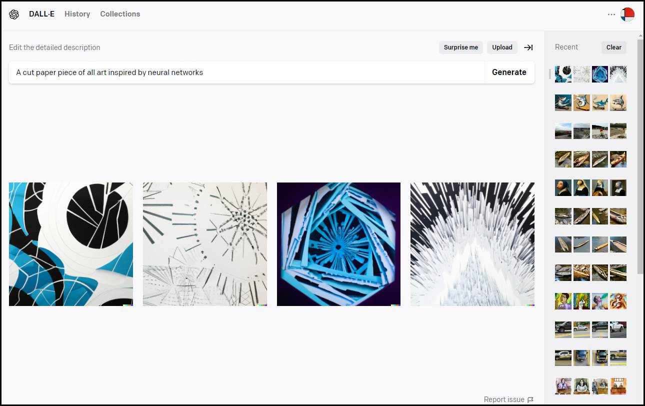
DALL-E
Portmanteau of Dali and WALL-E
Sibling model to Codex
Image generation from text
Credit-based pricing
115 generations for $15 USD

Slide 39
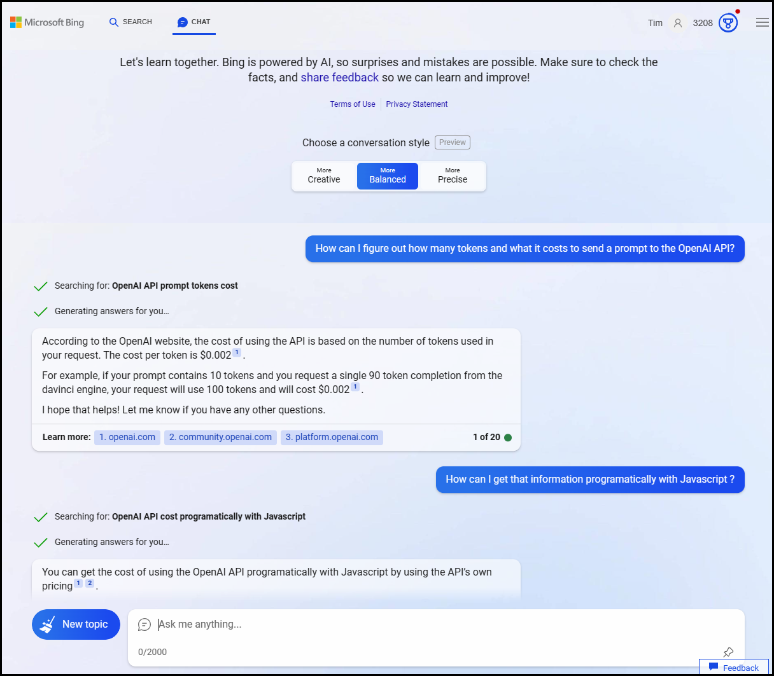
The New Bing
Traditional or chat UI
Temperature
Citations

Slide 40
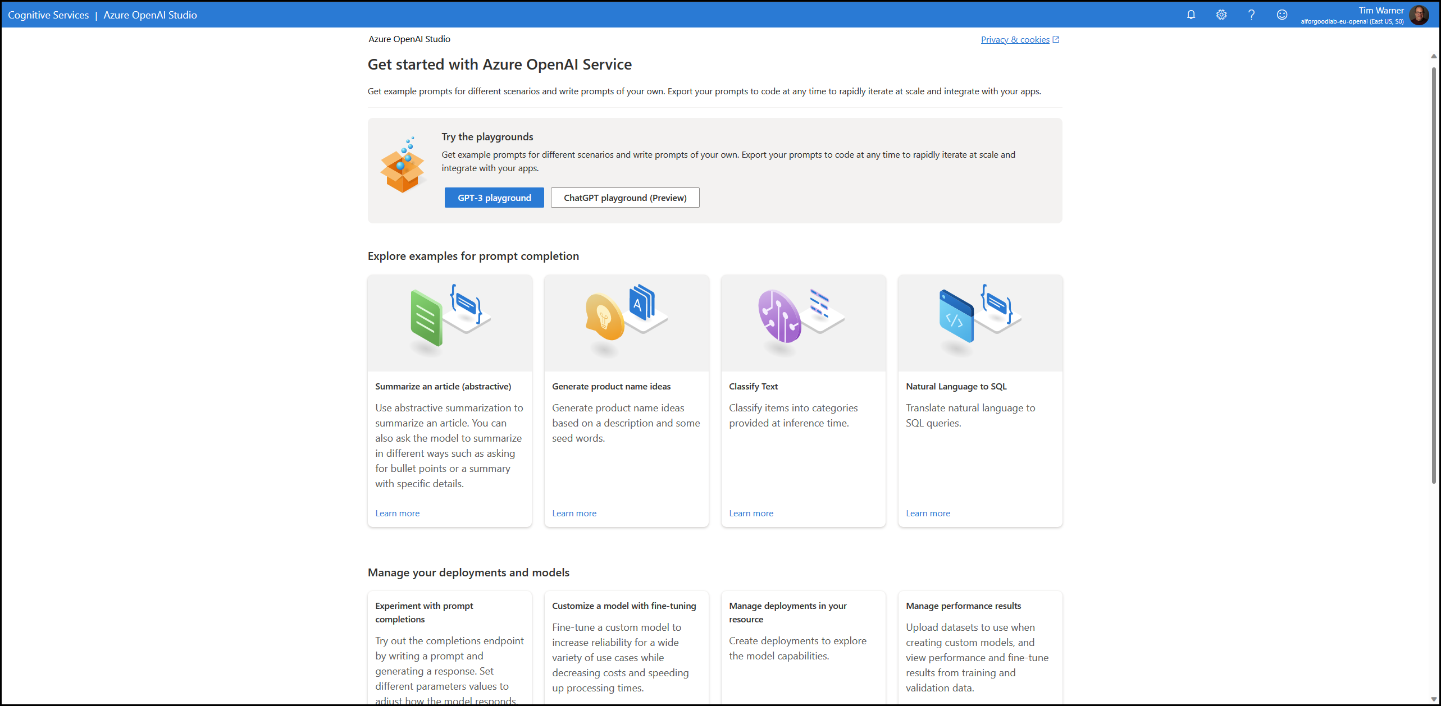
Azure OpenAI Service

Slide 41
Microsoft Responsible AI Principles
Fairness
Reliability and Safety
Privacy and Security
Inclusiveness
Transparency
Accountability

Slide 42
Practical Guidance for Businesses

Slide 43

Optimize for Cost
Evaluate language models (and OpenAI pricing plans) to find the right fit
Set up billing limits in your OpenAI account
Implement caching and rate limiting in your LOB apps that consume OpenAI APIs
Optimize token usage
Optimize number and size of your requests to OpenAI APIs
Azure has a Billing REST API and lots of cost management features, including budgeting and rich reporting

Slide 44

Optimize for Security
Azure OpenAI and private endpoint
Use OpenAI's Moderation API
Enable user IDs to every request
Provide your users with an issue reporting mechanism
"Red team" your application to counter adversarial input
Apply prompt engineering to canned inputs

Slide 45

Optimize for Reliability
Implement error handling and retry logic in your apps
Institute both load balancing and failover (redundancy) in your infrastructure
Remember we can't control OpenAI's availability
Remember Microsoft has a separate SLA for Azure OpenAI
Service Health dashboard

Slide 46

Optimize for Performance
Optimize input data
Clean, well-formatted, and concise
Prompt engineering
Set appropriate token length
Send requests in batches
Cache results
Monitor performance metrics

Slide 47

Questions? Comments? Curiosities?

Slide 48
Thank You!
Course materials: timw.info/chatgptclass
Connect: timw.info/linkedin

